Slide 1
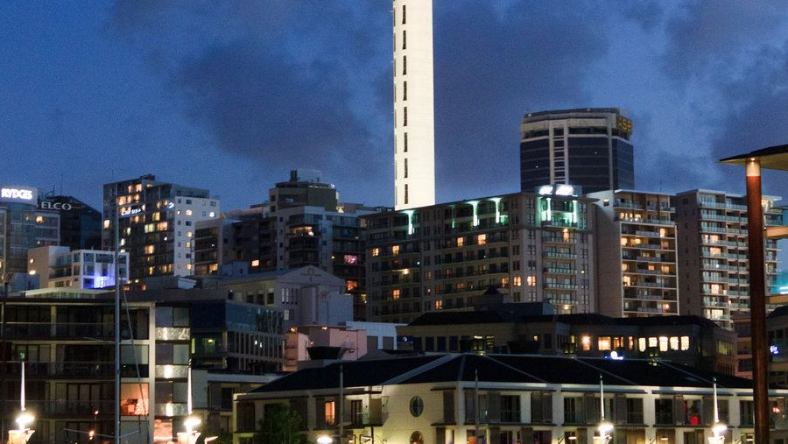
INTERSTING FACTS ABOUT NEWZEALAND
New Zealand means “land of the long white cloud”.
New Zealand is an independent nation and a member of British common wealth.
A kiwi is New Zealand’s native flightless bird and a slang term for a New Zealander. Kiwis call the fruit “kiwi fruit”.
The Mao, native of New Zealand largest bird in the history with 12 feet tall and 300 kg weight.
New Zealand is the first country in the world to see each new day.

Slide 2

WHY STUDY IN NEW Zealand ?
Based on the new rules, an international student who apply for level 8 and above programs can get up to 3years of stay back
Students can get paid internship of 20hrs per week
Can Work full time during off sessions
get post study work for 1year up to 3years
affordable fees and expenses
diploma programs are equal to master program
getting a job with a diploma or PG diploma is very easy

